Slide 1
Mobility network models of COVID-19 explain inequities and inform reopening
A literature review and what can we learn from it
Notes:
I'm going to present a short literature review of this paper published on nature, and as well what can we learn from it. This hopefully can help us generate some new ideas of our project

Slide 2
Brief Summary
“Superspreader” locations account for majority of infections (20% - 80% rule)
Restricting maximum occupancy at each location is recommended (over uniformly reducing visit to other places)
Disadvantaged racial and socioeconomic groups faces higher infection rates (less decrease in mobility, and often visit more crowded places)
Notes:
I will start with a quick summary of the key ideas. The first point is that among all locations, there are superspreaders that account for the majority of infections. The scale is roughly 20%-80%
They also concluded that restricting maximum occupancy at each location is better than uniformly reducing visit
The third point is .... The reason is that those groups usually have less decrease in mobility, and the places they visit are often more crowded

Slide 3
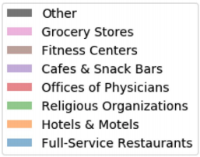
Terminology
Points of interest (POIs)
Non residential locations
Census Block Groups (CBGs)
SEIR model
Notes:
POIs are non-residential locations that people visit , such as restaurants, grocery stores, religious establishments and so on.
SEIR model can track the trajectory of both CBG and POI

Slide 4
Data
Description
cell phone geolocation data from SafeGraph
Census block groups
at 10 of the most largest metropolitan areas
From March 1- May 2, 2020
Construct fine-grained dynamic mobility networks
From each POIs:
Hourly number of visitors, median visit duration …
Areas in square feet, NAICS category …
Notes:
From US Census data, each CBG ci is labeled with its population Nci , income distribution, and racial and age demographics
North American Industry Classification System (NAICS) category (e.g., fitness center, full-service restaurant)
5-year ACS (2013–2017) to extract the median household income, proportion of white residents, and proportion of black residents of each CBG
For the total population of each CBG, we use the most recent one-year estimates (2018)

Slide 5
Models
For each of the 10 metro area, study mobility patterns of individual between CBGs and POIs --> mobility networks
Overlay a SEIR model on each mobility network : each CBG maintains a [S,E,I,R] state
Only three free/constant parameters:
(1) transmission rates at POIs,
(2) transmission rates at CBGs, and
(3) the initial proportion of exposed individuals
Another SEIR model for each metro area
Notes:
Note that infections occur at both pois and cbgs, with the mobility network governing how subpopulations from different CBGs interact as they visit POIs

Slide 6
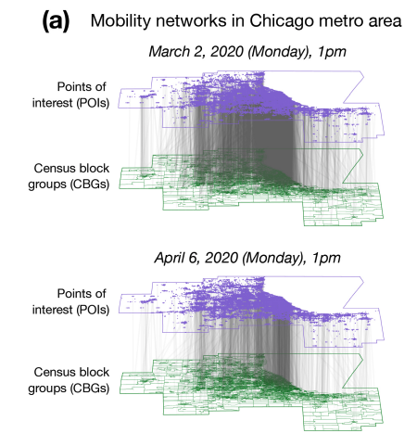

Slide 7
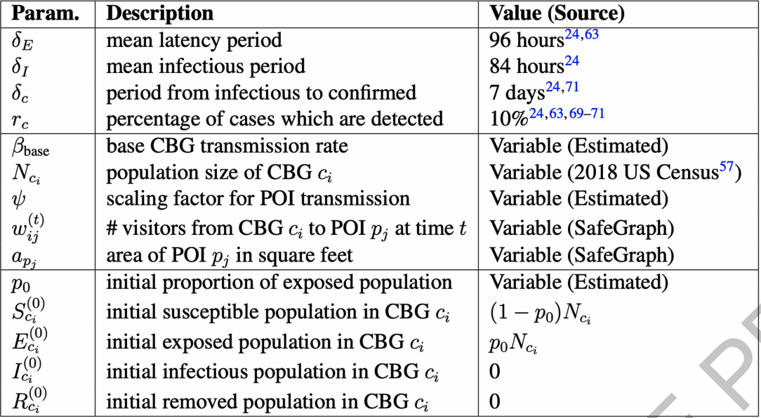
Notes:
They did some calibration and predicton to validate the models

Slide 8
Findings
Magnitude of mobility reduction and its timing are important
Small number of POIs account for a majority of predicted infections
Chicago: 10% of POIs accounted for 85% of the predicted infections at POIs
But the impact is time-dependent
Reopening and risk of reopening
Reopening with reduced maximum occupancy is recommended
Pros: capping at 20% max occupancy in Chicago cut down >80% infections, lost only 42% of over all visit
Where to reopen? Full-service restaurants, gyms, hotels, cafes, religious organizations, and limited-service restaurants are risky
Notes:
85% (95% CI, 83%–87%)
restaurants and fitness centers contributed less to predicted infections over time, likely due to lockdown orders closing these POIs, while grocery stores remained steady or even grew in their contribution, which concords with their status as essential businesses.
one can achieve a disproportionately large reduction in infections with a small reduction in visits. The trade off between infection and economic is not linear
reduced maximum occupancy takes advantage of the time-varying visit density within each POI, disproportionately reducing visits to the POI during the most risky high-density periods, but leaving visit counts unchanged during less risky periods.
These risks are summed over all POIs in the category, but the relative risks after normalizing by the number of POIs were broadly similar (ED Figure 5c). These categories were predicted to more be dangerous because, in the mobility data, their POIs tended to have higher visit densities and/or visitors stayed there longer

Slide 9
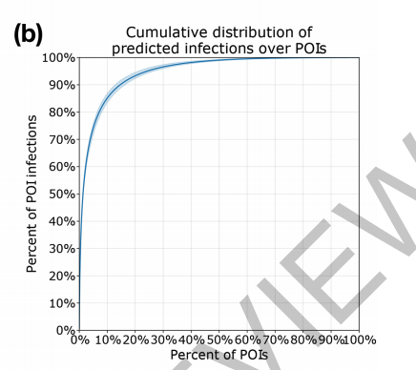
Notes:
The model predicts that most infections at POIs occur at a small fraction of “super-spreader” POIs

Slide 10
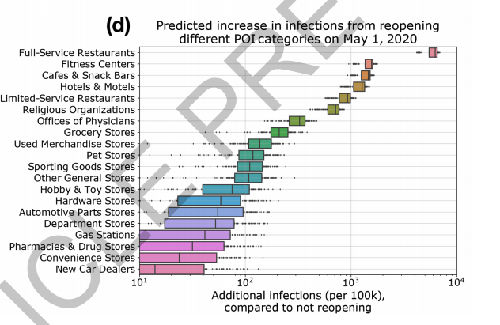
Notes:
Reopening full-service restaurants has the largest predicted impact on infections, due to the large number of restaurants as well as their high visit densities and long dwell times

Slide 11
Findings cont.
Demographic disparities : racial composition and median income of CBG
Bottom decile for income have higher risk of infection
CBGs with fewer white residents have higher risk of infection
Low income
Smaller reduction in mobility → not able to work from home
POIs visited are smaller in area and more crowed, visits are also longer

Slide 12
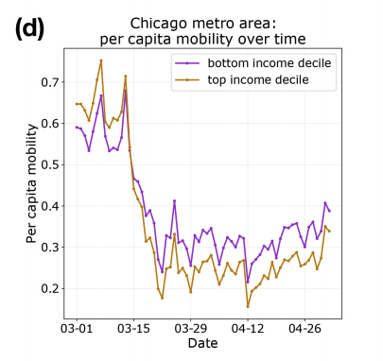
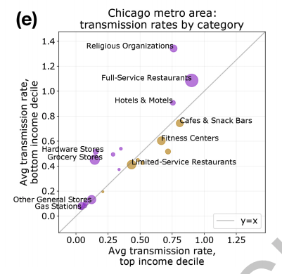

Slide 13
Ideas in Common
Geographic Heterogeneity
SEIR model in prediction
But lots of differences……
Notes:
They have data from census track
10% 20% 30% capacity control vs RL model that learns the level of reduction
Real data vs hypothetical data

Slide 14
New ideas?
A dynamic/evolving SEIR model and Mobility pattern
Grouping similar POIs

